Slide 1
Logistic Regression
Supervised Learning
Classification
Binary
Multi-nominal

Slide 2
An activation function is a function that is added into an artificial neural network in order to help the network learn complex patterns in the data. Sigmoid: The sigmoid activation function is also called the logistic function. It is the same function used in the logistic regression classification algorithm. The function takes any real value as input and outputs values in range 0 to 1.

Slide 3
Activation Functions
Sigmoid vs Softmax
The sigmoid function is used for the two-class logistic regression, whereas the softmax function is used for the multiclass logistic regression.
The main advantage of using Softmax is the output probabilities range. The range will 0 to 1, and the sum of all the probabilities will be equal to one. If the softmax function used for multi-classification model it returns the probabilities of each class and the target class will have the high probability.

Slide 4
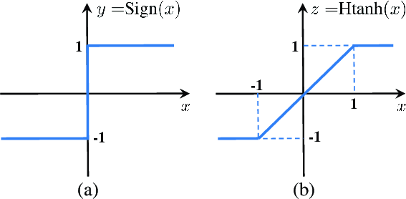
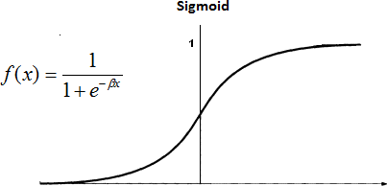
Activation Functions

Slide 5
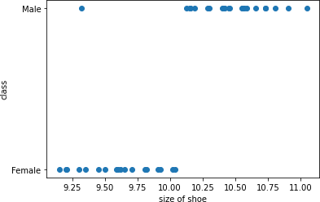
Linear Regression
Y = MX + C
Best Fit Line
M = Slope
C = Intercept X = Data Point

Slide 6
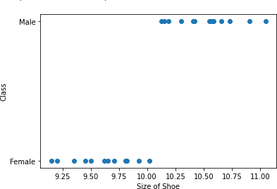

Logistic Regression
>=.50
Logit(x) = MX + C
.50
M = Slope
C = Intercept X = Data Point
<.50

Slide 7
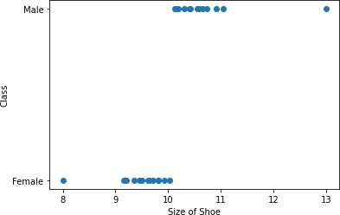
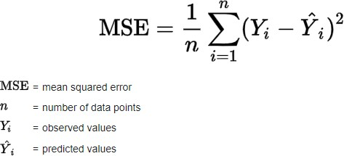
Linear Regression
>=.50
Y = MX + C
Best Fit Line
M = Slope
C = Intercept X = Data Point
.50
<.50

Slide 8
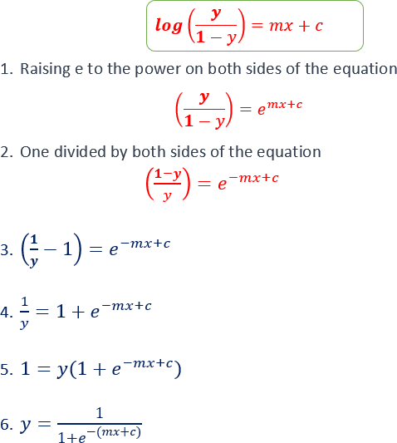
Logistic Regression
( )
( )
(

Slide 9
Logistic Regression
Logistic regression is a linear classifier, so you’ll use a linear function 𝑓(𝐱) = 𝑏₀ + 𝑏𝑥 or 𝑓(𝐱) = 𝑏₀
+ 𝑏₁𝑥₁ + ⋯ + 𝑏ᵣ𝑥ᵣ, also called the Logit. The variables 𝑏₀, 𝑏₁, …, 𝑏ᵣ are the estimators of the regression coefficients, which are also called the predicted weights or just coefficients.
.50

Slide 10
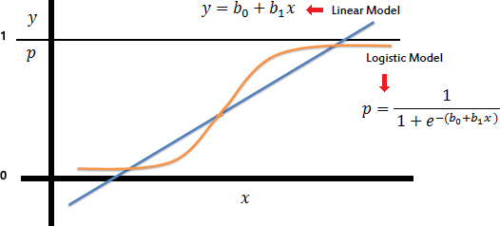
Linear vs Logistic Regression
y = mx + c
0.5
Abu Bakar Siddique Mahi

